Slide 1

HERON Wind/NPP Case
FORCE Overview and Training
April 4-6, 2023
Gabriel J. Soto Gonzalez, Paul Talbot
Modeling and Simulation Engineer
Idaho National Laboratory

Slide 2
Outline
Wind and Nuclear Power Plant (NPP) Case
Basic schematic of Integrated Energy Systems (IES) components
Market and Weather scenarios
Holistic Energy Resource Optimization Network (HERON) Workflow
HERON Input script
Running HERON simulation in Debug Mode
Running HERON simulation in Sweep Mode
Adding Arbitrage

Slide 3
NPP and Wind
Stronger Together (Sometimes)

Slide 4
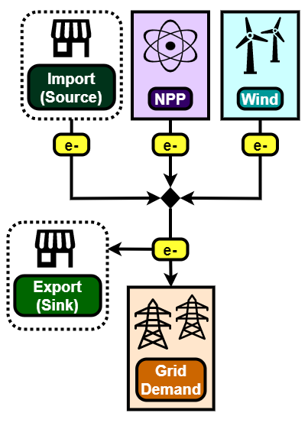
Basic Schematic of IES
Nuclear Power Plant
Can flex from 0%–100% of rated capacity
Wind Farm
Also has rated capacity, but varies based on wind speeds
Capacity factor taken from synthetic histories
Electricity Grid
Demand
also taken from synthetic histories
External Market (Source/Sink)

Slide 5
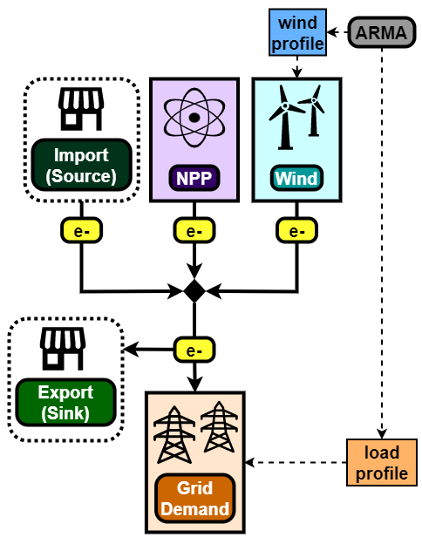
Basic Schematic of IES
Given:
IES (NPP + Wind Farm)
Market and Geographic Region
Need to find:
Capacities
Dispatch strategies
Goal(s):
Satisfy demand
Minimize costs/maximize profits (net present value [NPV])
Recall:
Load profiles and weather contain uncertainty
Uncertainty represented using synthetic time histories (Auto-Regressive Moving Average [ARMA])

Slide 6
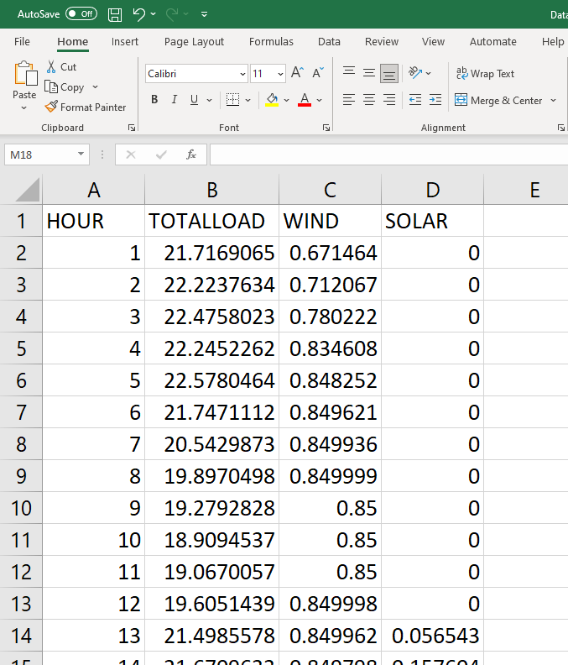
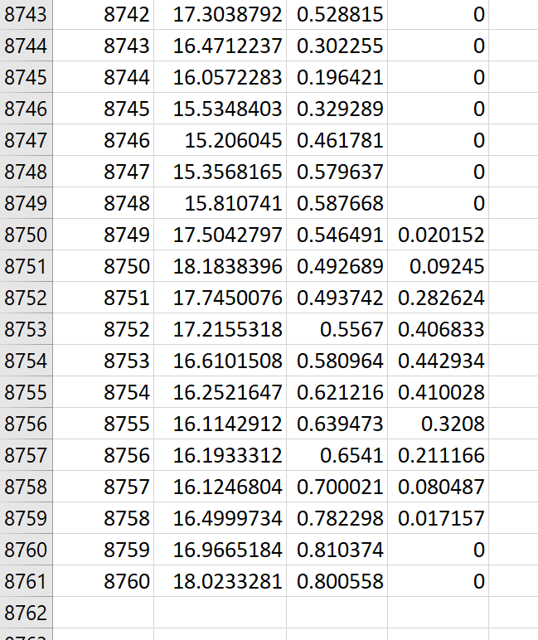
Market and Weather Scenarios
HERON\tests\integration_tests\ARMA\NYISO\Data_0.csv
Normally, pre-HERON steps include training an ARMA model
Some RAVEN-trained models included
NYISO data for Load, Wind, Solar
Load: [GW]
Wind, Solar: [unitless fraction]

Slide 7
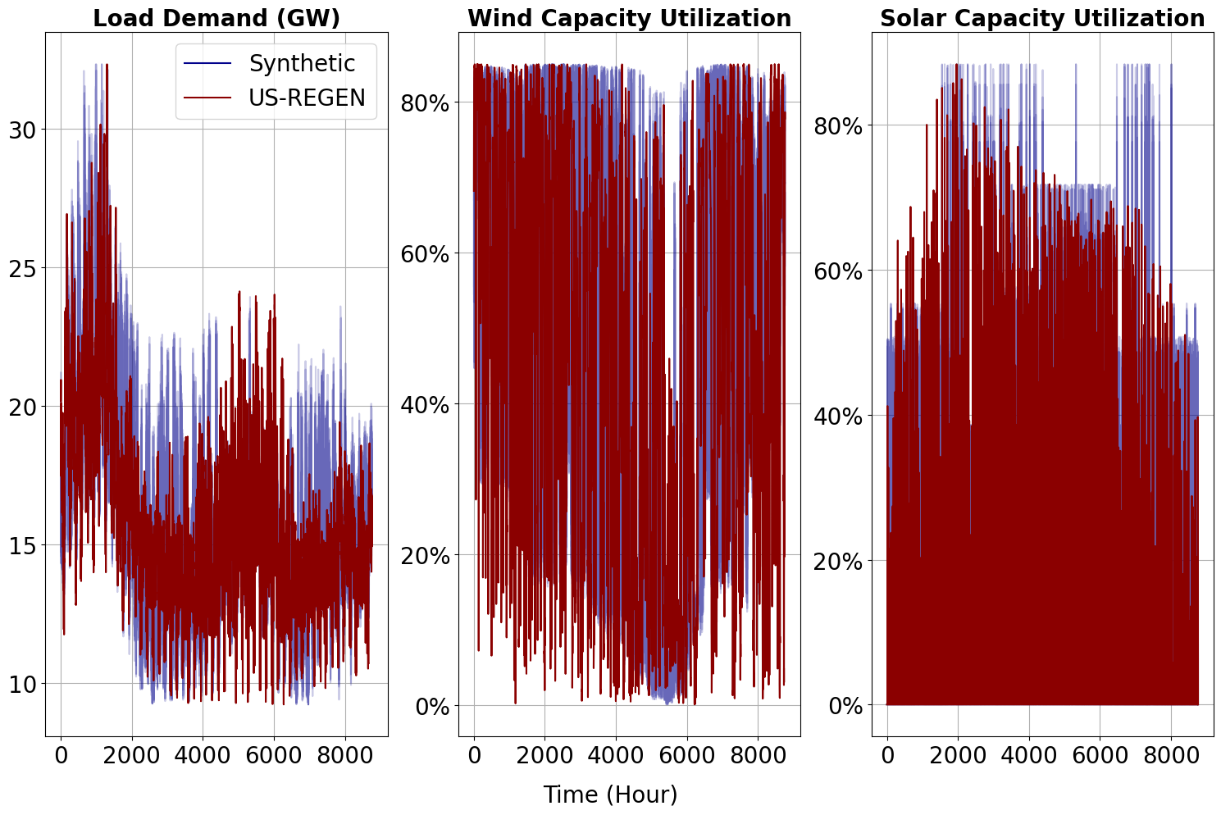
Market and Weather Scenarios
HERON\tests\integration_tests\ARMA\NYISO\Data_0.csv
ARMA is trained by segmenting full dataset
1 year of data broken down into:
2 representative clusters
each 24 hours long
These are parameters decided by the users, kept simple here

Slide 8
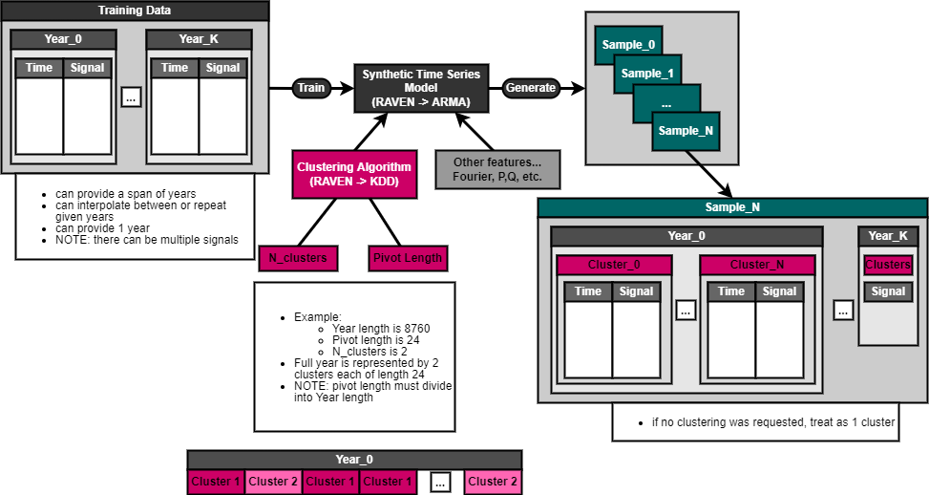
HERON Workflow
All the hard work has already been done!
From our given ARMA, synthetic histories will:
Contain a single year
Contain two clusters per year
Contain three signals per cluster (Load, Wind, Solar)
Contain 24 time points per signal
For a multi-year simulation, HERON can repeat yearly data

Slide 9
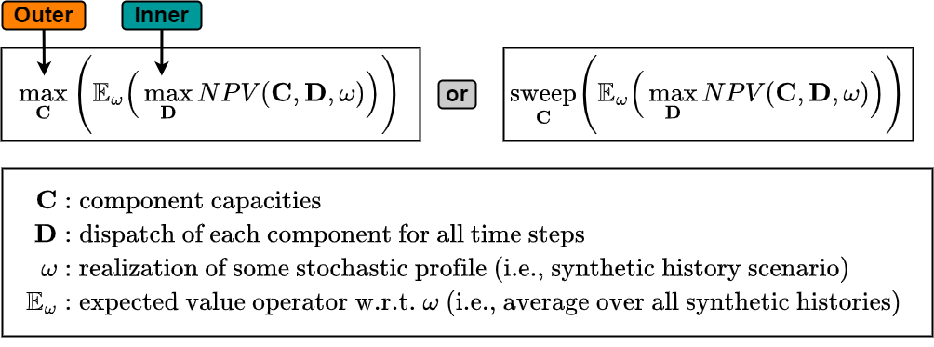
HERON Workflow
Two-stage optimization or sweep:
Outer: optimizing component capacities using RAVEN Gradient Descent
Inner: optimizing dispatch of resources using Pyomo and requested solver
GNU Linear Programming Kit [glpk]
Coin-or Branch-and-cut [cbc]
Interior Point Optimizer [ipopt]
Modified from:
A. Epiney, C. Rabiti, P. Talbot, A. Alfonsi, “Economic analysis of a nuclear hybrid energy system in a stochastic environment including wind turbines in an electricity grid” Applied Energy (2020)

Slide 10
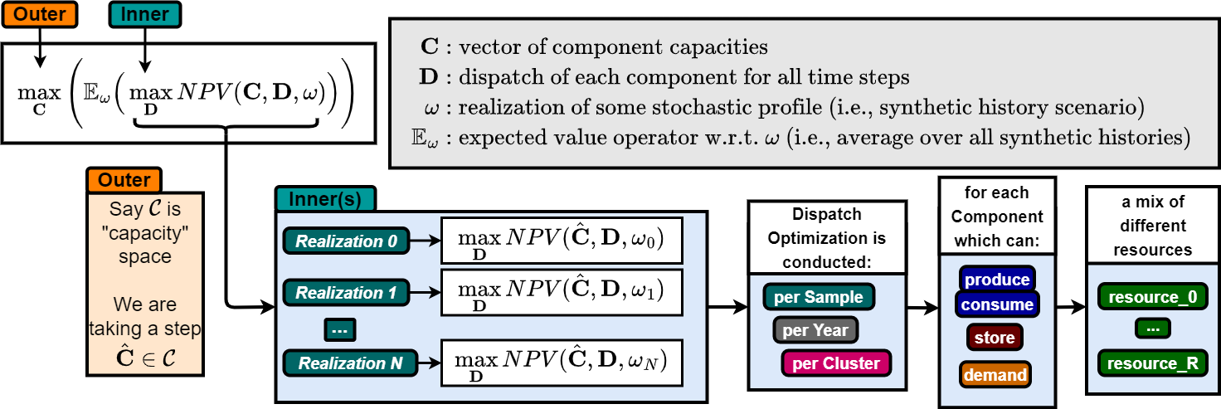
HERON Workflow

Slide 11
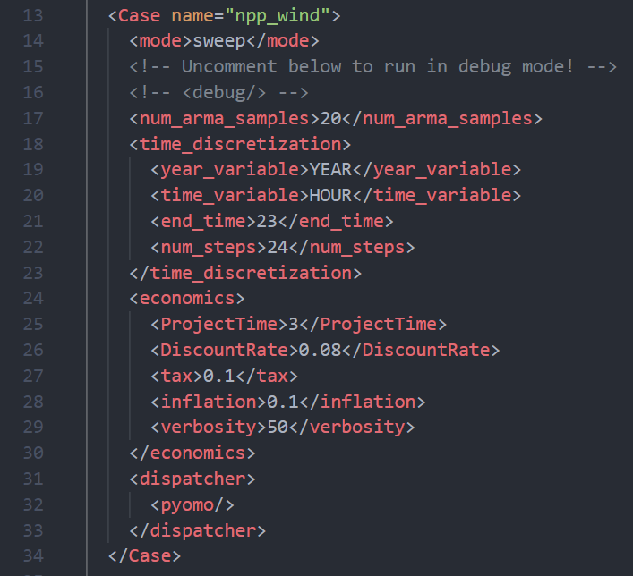
HERON Input Script
Case
HERON\tests\workshop\wind\heron_input.xml
num_arma_samples = 20
20 inner samples used to get expected value of metric (NPV) in Outer
ProjectTime= 3
Each inner sample simulates 3 project years
<time_discretization>
Each cluster/segment has 24 time steps
NOTE: clusters/segments automatically read from ARMA

Slide 12
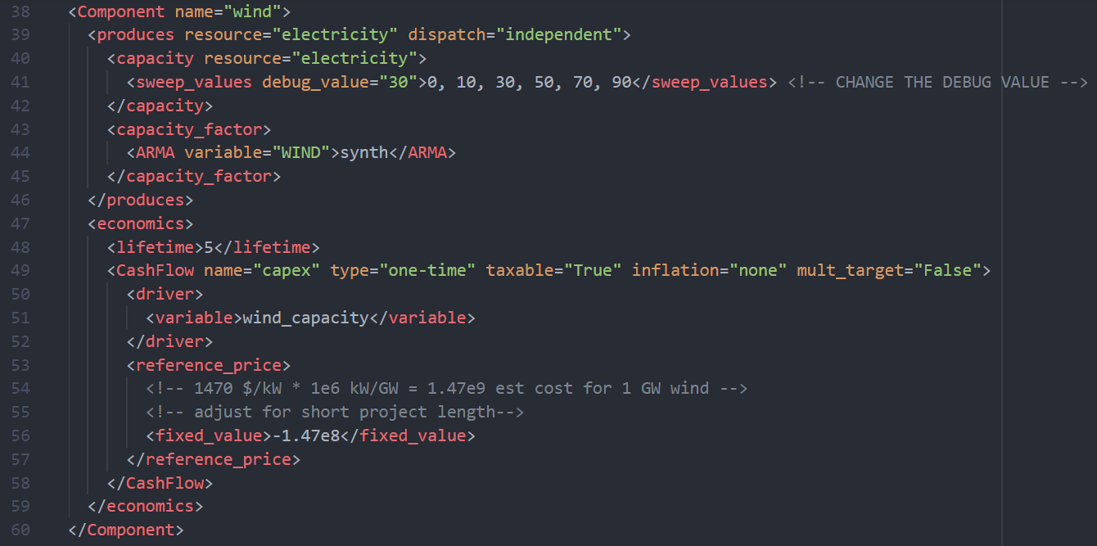
HERON Input Script
Components: Wind
HERON\tests\workshop\wind\heron_input.xml
<capacity>
This is the rated capacity of the Wind Farm
Currently, we sweep through some values
Can be fixed, opt, etc.
<capacity_factor>
Actual usage of capacity per unit time
Using synthetic histories

Slide 13
NPP and Wind
Let’s run some simulations!

Slide 14
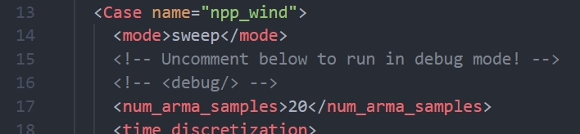
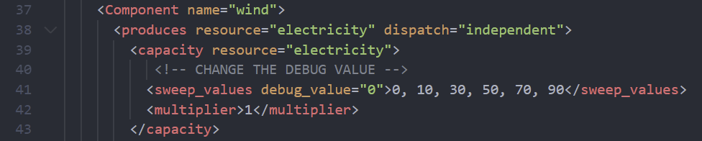
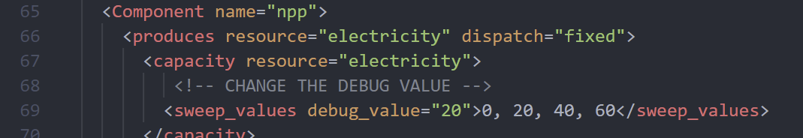
Running in Debug Mode
HERON\tests\workshop\wind\heron_input.xml
Uncomment <debug> line
Note that this overrides some parameters
Only using 1 sample
Only using 1 year
Change debug values!
HERON only use these in debug mode, overrides sweep values

Slide 15
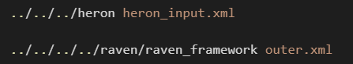
Running in Debug Mode
Run HERON, then outer.xml:
Things to try in debug mode:
Wind = 0; NPP = 20
Wind = 10; NPP = 20
Switch NPP to dispatch=“independent” or dispatch=“fixed”
Pause here – Check Network plot!
HERON\tests\workshop\wind\heron_input.xml

Slide 16
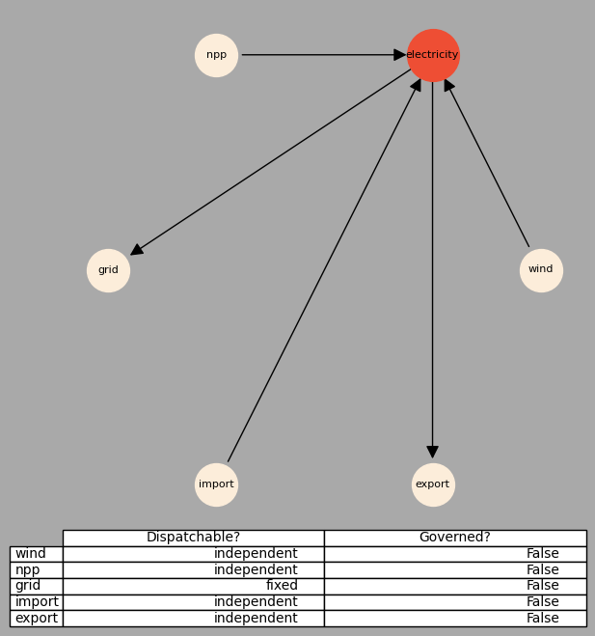
Running in Debug Mode
Run HERON, then outer.xml:
Things to try in debug mode:
Wind = 0; NPP = 20
Wind = 10; NPP = 20
Switch NPP to dispatch=“independent” or dispatch=“fixed”
HERON\tests\workshop\wind\network.png

Slide 17
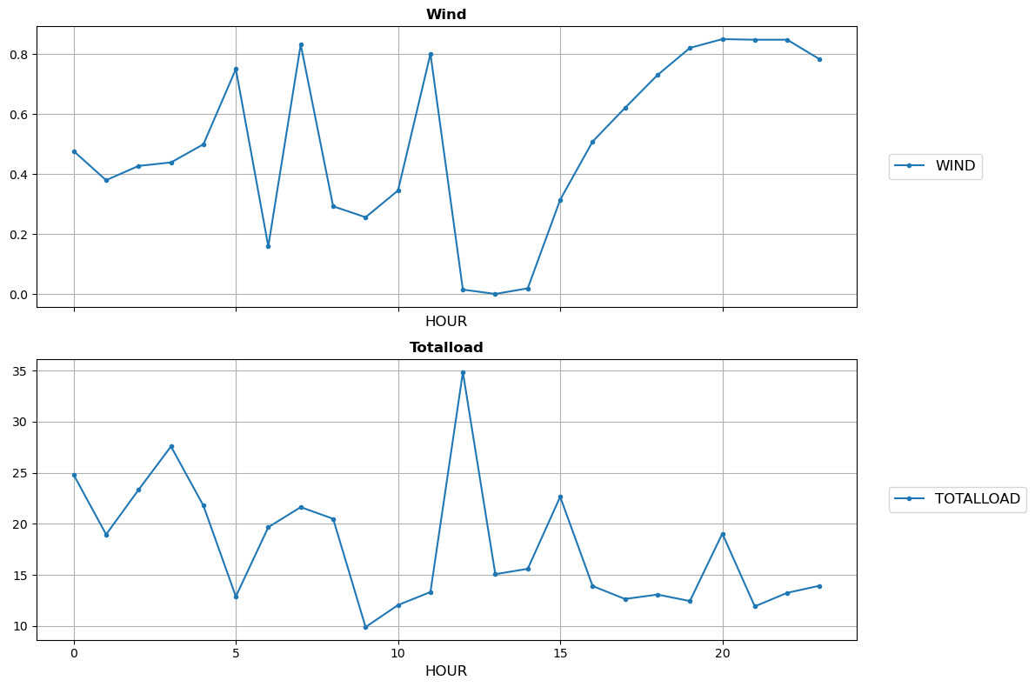
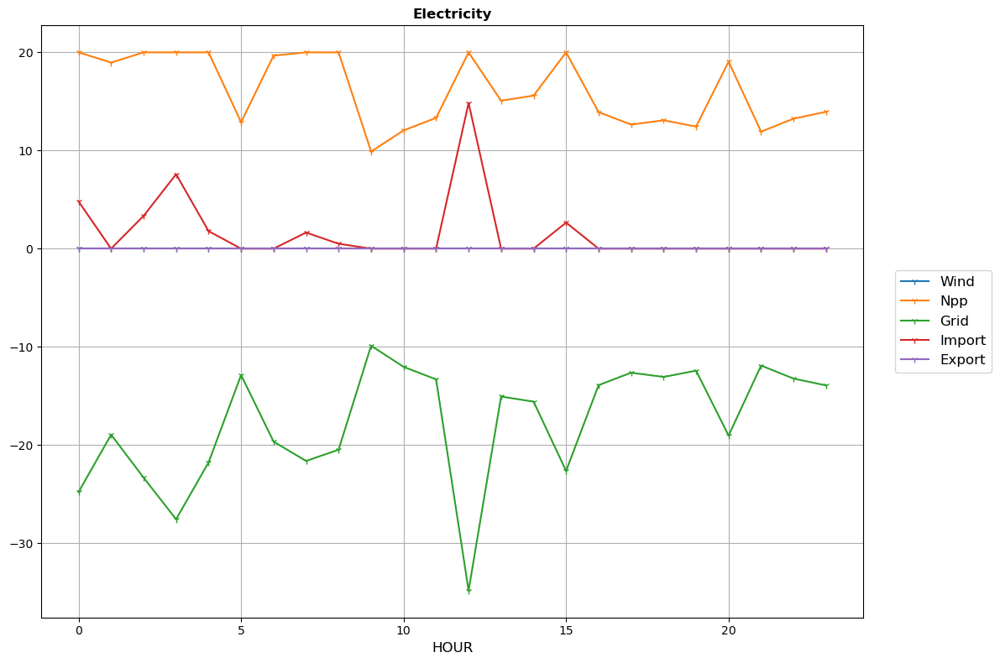
Running in Debug Mode
HERON\tests\workshop\wind\npp_wind_o
Stochastic History for Single Cluster
Dispatch of Electricity
Wind = 0GW
NPP = 20GW, independent dispatch

Slide 18
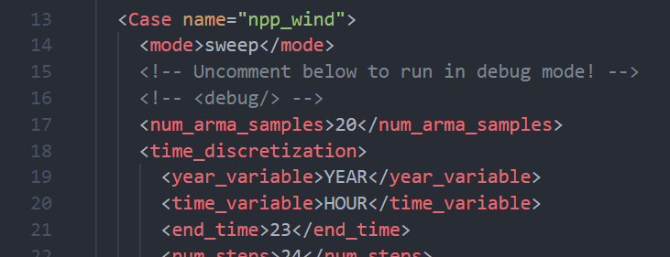
Doing a Full Sweep
Run HERON, then outer.xml:
Things to change:
Comment out the <debug/> line
Input desired sweep values for:
Wind Capacities
NPP Capacities
Pause here
HERON\tests\workshop\wind\heron_input.xml

Slide 19
Doing a Full Sweep
Results!
Zoomed-in plot

Slide 20
After running in debug mode and getting a coarse look via sweep runs, might be time for an optimization run
Will take a while depending on computation resources
best to do on your own or on High Performance Computing (HPC) machines
Fun things to toggle—How do these affect NPV?:
Project time > 3 years
Project time > component lifetimes
Add depreciation to components

Slide 21
NPP and Wind With Storage
Even Stronger with Arbitrage!

Slide 22
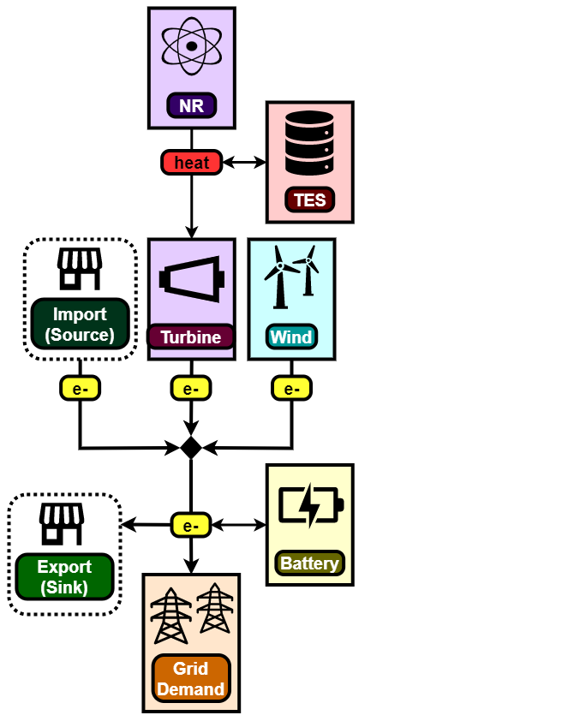
Basic Schematic of IES
Nuclear Power Plant:
Nuclear Reactor
Is now decoupled from electricity generation
Produces heat that can be converted to electricity
Turbine
Converts heat into electricity via a transfer function (η= 0.33)
Thermal Energy Storage (TES)
Storage unit that can charge with heat and discharge via some dispatch strategy

Slide 23
Basic Schematic of IES
Wind Farm
Also has rated capacity, but varies based on wind speeds
Capacity factor taken from synthetic histories
Battery
Storage for electricity resource
Electricity Grid
Demand
also taken from synthetic histories
External Market (Source/Sink)

Slide 24
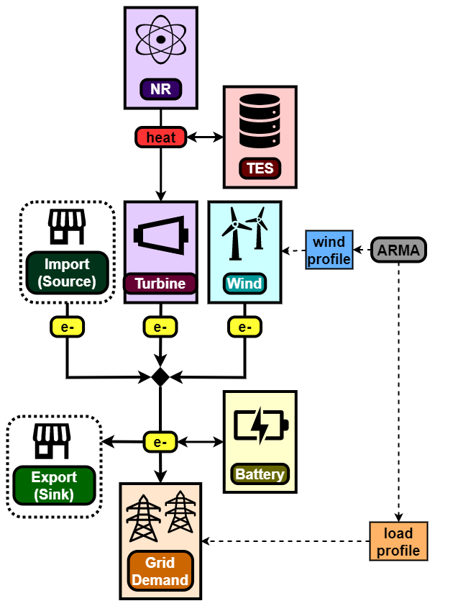
Basic Schematic of IES
Given:
IES (NPP + TES + Wind Farm + Battery)
Market and Geographic Region
Need to find:
Capacities
Dispatch strategies
Goal(s):
Satisfy demand
Minimize costs/maximize profits (NPV)
Recall:
Load profiles and weather contain uncertainty
Uncertainty represented using synthetic time histories (ARMA)

Slide 25
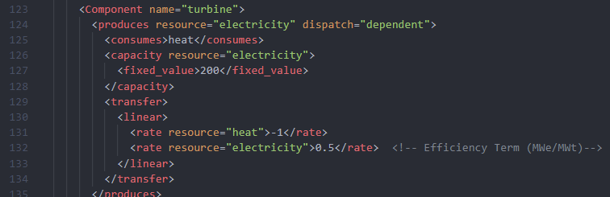
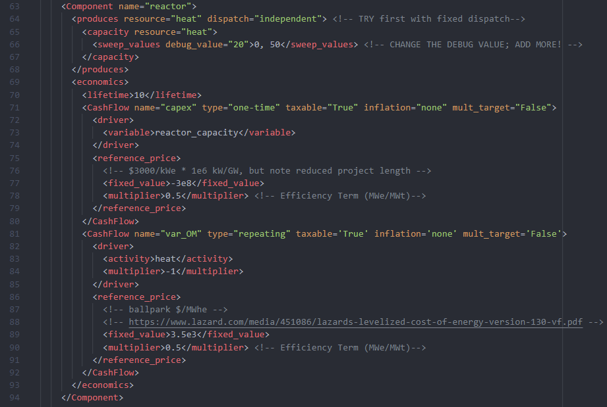
HERON Input Script
HERON\tests\workshop\wind\heron_input_storage.xml
Turbine converts heat to electricity
Linear transfer rate – efficiency
Dispatch is “dependent”
Capacity large enough to take in NPP and TES production
Reactor generates heat
Keeping previous costs ($/GWe)
Efficiency used as multiplier (GWt/GWe)
Efficiency
Different resource
Efficiency

Slide 26
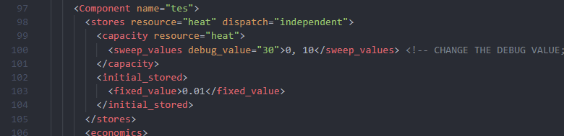
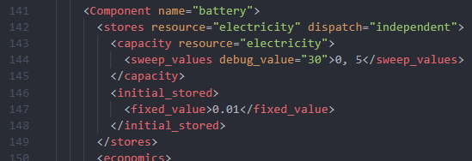
HERON Input Script
HERON\tests\workshop\wind\heron_input_storage.xml
TES stores heat
Assuming only CAPEX (capital expenditures) cost
$30/MWt
Battery stores electricity
Assuming only CAPEX (capital expenditures) cost
$151/MWe

Slide 27
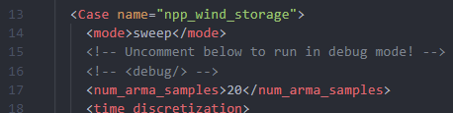
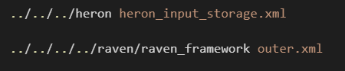
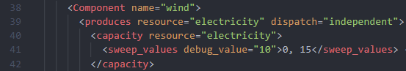
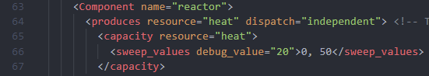
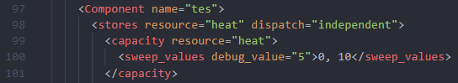
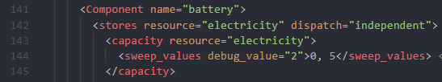
Running in Debug Mode
Run HERON, then outer.xml:
Things to try in debug mode:
Component sizes:
Wind = 30; Reactor = 20
TES = 30; Battery = 30
Switch Reactor to dispatch=“independent” or dispatch=“fixed”
Pause here – Check Network plot!
HERON\tests\workshop\wind\heron_input_storage.xml

Slide 28
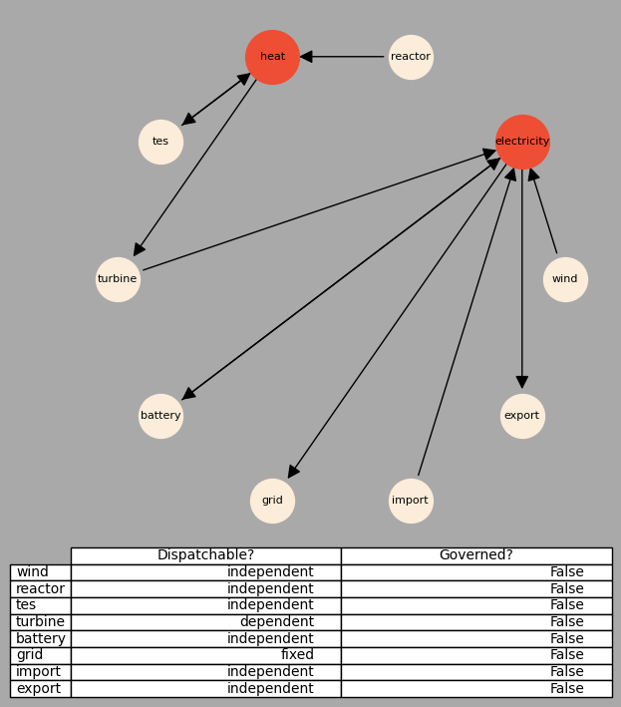
Running in Debug Mode
Run HERON, then outer.xml:
Things to try in debug mode:
Component sizes:
Wind = 30; Reactor = 20
TES = 30; Battery = 30
Switch Reactor to dispatch=“independent” or dispatch=“fixed”
HERON\tests\workshop\wind\network.png

Slide 29
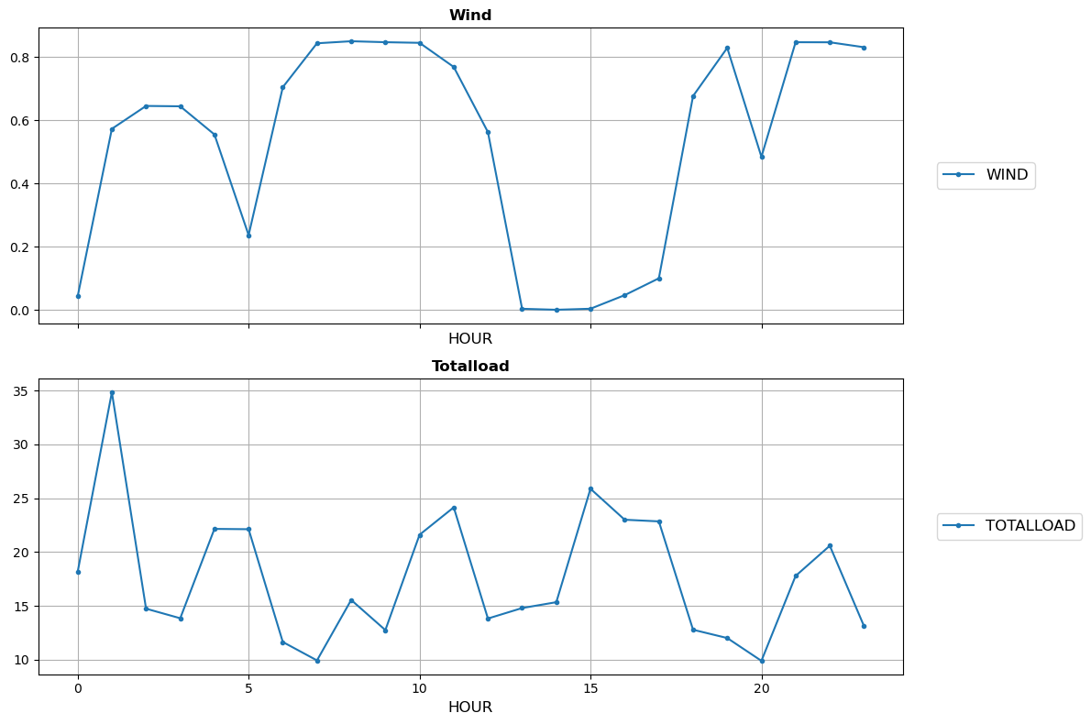
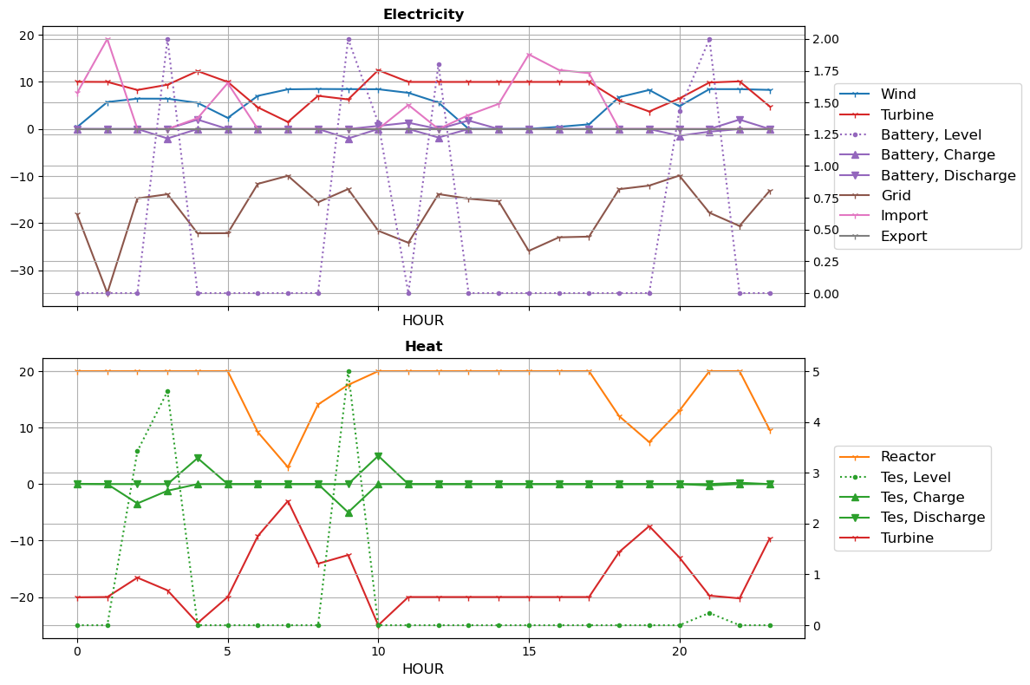
Running in Debug Mode
HERON\tests\workshop\wind\npp_wind_storage_o
Stochastic History for Single Cluster
Dispatch of Heat and Electricity
Wind = 10 Gwe
Reactor = 20 GWt (independent dispatch)
TES = 5 GWt
Battery = 2 GWe

Slide 30
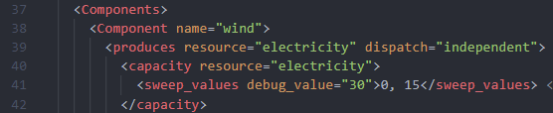
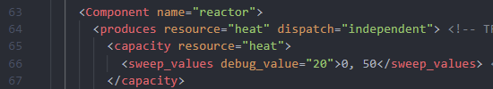
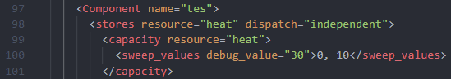
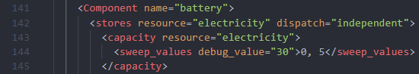
Doing a Full Sweep
Run HERON, then outer.xml:
Things to change:
Comment out the <debug/> line
Input desired sweep values for:
Wind Capacity
Reactor Capacity
TES Capacity
Battery Capacity
HERON\tests\workshop\wind\heron_input_storage.xml

Slide 31
Doing a Full Sweep
Some results from multi-dimensional results
Try different sweep values!
Fixed Reactor output
Higher Grid Demand

